Slide 1
JAVA METHODS, TYPES OF JAVA METHODS, RECURSION, CALLING METHODS, AND EXAMPLES
-Pranali chougule

Slide 2
Java method
A method in Java is a set of instructions grouped together to perform an action.
A Java method can perform some specific tasks without returning anything.
It helps avoid code duplication and makes the program easier to manage
A method is like a function i.e. used to expose the behavior of an object.
Advantage of Method:
Code Reusability
Code Optimization

Slide 3
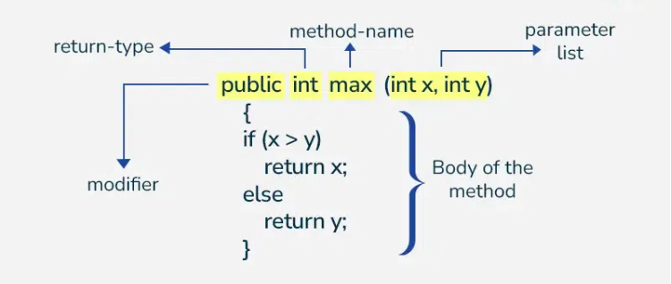
Method declaration

Slide 4
Method Declaration
In general, method declarations have 6 components:
1. Modifier: It defines the access type of the method i.e. from where it can be accessed in your application. In Java, there 4 types of access specifiers.
public: It is accessible in all classes in your application.
protected: It is accessible within the class in which it is defined and in its subclasses.
private: It is accessible only within the class in which it is defined.
default: It is declared/defined without using any modifier. It is accessible within the same class and package within which its class is defined.
2. The return type: The data type of the value returned by the method or void if does not return a value. It is Mandatory in syntax.
3. Method Name: the rules for field names apply to method names as well, but the convention is a little different. It is Mandatory in syntax.
4. Parameter list: Comma-separated list of the input parameters is defined, preceded by their data type, within the enclosed parenthesis. If there are no parameters, you must use empty parentheses (). It is Optional in syntax.
5. Exception list: The exceptions you expect by the method can throw; you can specify these exception(s).
6. Method body: it is enclosed between braces. The code you need to be executed to perform your intended operations.

Slide 5
Types of Methods
There are two types of methods in Java:
1. Predefined Method
In Java, predefined methods are the method that is already defined in the Java class libraries is known as predefined methods.
It is also known as the standard library method or built-in method.
We can directly use these methods just by calling them in the program at any point.
2. User-defined Method
The method written by the user or programmer is known as a user-defined method.
These methods are modified according to the requirement.

Slide 6
Ways to Create Method
There are two ways to create a method in Java:
Instance Method:
Access the instance data using the object name.
Declared inside a class.
Syntax:
// Instance Method
void method_name(){
body // instance area
}
2. Static Method:
Access the static data using class name.
Declared inside class with static keyword.
Syntax:
//Static Method
static void method_name(){
body // static area
}

Slide 7
Recursion
In Java, Recursion is a process in which a function calls itself directly or indirectly is called recursion and the corresponding function is called a recursive function.
Using a recursive algorithm, certain problems can be solved quite easily.
A recursive method typically has two parts:
Base case: A condition that stops the recursion.
Recursive case: The part where the method calls itself.

Slide 8
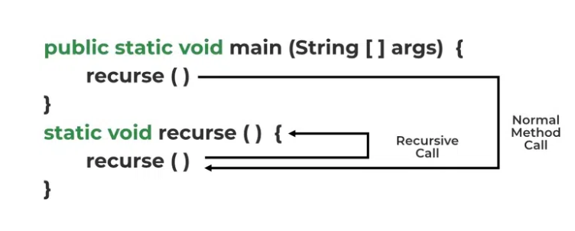
Example:
int fact(int n)
{
if (n < = 1) // base case
return 1;
else
return n*fact(n-1);
}
Working of Recursion
The idea is to represent a problem in terms of one or more smaller sub-problems and add base conditions that stop the recursion. For example, we compute factorial n if we know the factorial of (n-1). The base case for factorial would be n = 0. We return 1 when n = 0.

Slide 9
Calling method
In Java, a method is called using its name followed by parentheses, along with any required arguments (if applicable). Here's a concise way to call a method:
Steps to Call a Method:
Define the method: Create a method with a specific name.
Invoke (Call) the method: Use the method's name with appropriate arguments.

Slide 10
Calling Static Method
In Java, a static method is one that belongs to the class rather than to instances (objects) of the class.
You can call a static method directly using the class name without needing to create an object of the class.
Static methods can only access other static members (variables or methods) of the class.
The main() method is a special example of a static method, as it is the entry point for any Java program.
How to Call a Static Method:
Define the static method: Use the static keyword before the method name.
Call the method: Use ClassName.methodName() to call the static method.

Slide 11
Calling the Pre-Defined Method
.
.
In Java, pre-defined methods are methods that are already provided by Java's standard library.
These methods are part of various built-in classes such as String, Math, Object, etc.
You can directly call these methods without defining them, as they are already implemented in the core classes
examples include Math.sqrt(), String.length(), System.out.println(), etc
Example:
public class Example {
public static void main(String[] args) {
// Create an object of the Object class
Object obj = new Object();
// Call the pre-defined method hashCode()
int hashValue = obj.hashCode();
// Print the hash code value
System.out.println("Hash code value: " + hashValue);
}
}

Slide 12
Calling User-Defined Method
To call a user-defined method, first, we create a method and then call it.
A method must be created in the class with the name of the method, followed by parentheses ().
The method definition consists of a method header and method body.
We can call a method by using the following:
method_name(); //non static method calling
If the method is a static method, we use the following:
obj.method_name(); //static method calling
Where obj is the object of the class.

Slide 13
public class MethodCallExample
{
//user-defined static method
static void showMessage()
{
System.out.println("The static method invoked.");
}
//user-defined non-static method
void displayMessage()
{
System.out.println("Non-static method invoked.");
}
public static void main(String[] args)
{
//calling static method without using the object
showMessage(); //called method
//creating an object of the class
MethodCallExample me=new MethodCallExample();
//calling non-static method
me.displayMessage(); //called method
}
}

